Slide 1
Title
Team Members:
B.PRASANTH(RA2211004050008)
E.G.PRADEEP(RA2211004050026)
Guided by,
DR.M.MATHAN KUMAR
Assistant Professor
DEPT OF ECE

Slide 2
ABSTRACT
Along with the commercialization of the Internet of Things (IoT) technology, the demand for long-range, low-power and long-range, large amount of data transmission arises. However, there has been no such communication technology to satisfy the transmission. The Wi-Fi is able to send large amounts of data with its broadband technology, but because of high power consumption, it has to use firm power. The LoRa technology is available for long-range and low-power communication but because of low transmission rate. The purpose of this study is to overcome those problems, design and suggest the multi interface communication module supporting LoRa technology
Key words:LoRa Technology,IoT,Long Range Communications,Energy Efficiency.

Slide 3
INTRODUCTION
PROBLEM STATEMENT: Interferences in Marine Communication.
SOLUTION : Using LoRa Technologies instead of using Traditional Communication Systems.
Maritime communication has always been a challenge due to the vast and unpredictable sea environment. Traditional systems like satellite are expensive and consume a lot of power. Closer to the shore, technologies are provide with some solutions, but they are not always energy-efficient, especially for small boats and battery-powered devices. LoRa (Long Range) technology, a type of Low Power Wide Area Network (LP-WAN), offers a better alternative by enabling long-distance communication. This makes it ideal for tracking boats, monitoring ocean conditions, and enhancing safety operations. LoRa is especially useful for small sailboats, unmanned vehicles, and sensor platforms that require reliable connectivity without draining their power sources. In this study, a LoRa-based system was tested for tracking Optimist Class sailboats, showing how this technology can improve maritime communication. The results confirm its efficiency in ensuring reliable, low-cost, and long-range connectivity in coastal areas.

Slide 4
BLOCK DIAGRAM
0.96 12C OLED DISPLAY
DH11 SENSOR
Computer (to send commands)
STM32 MICROCONTROLLER
STM32 MICROCONTROLLER
Computer (to send commands)
LR1278/SX1278
LR1278/SX1278

Slide 5
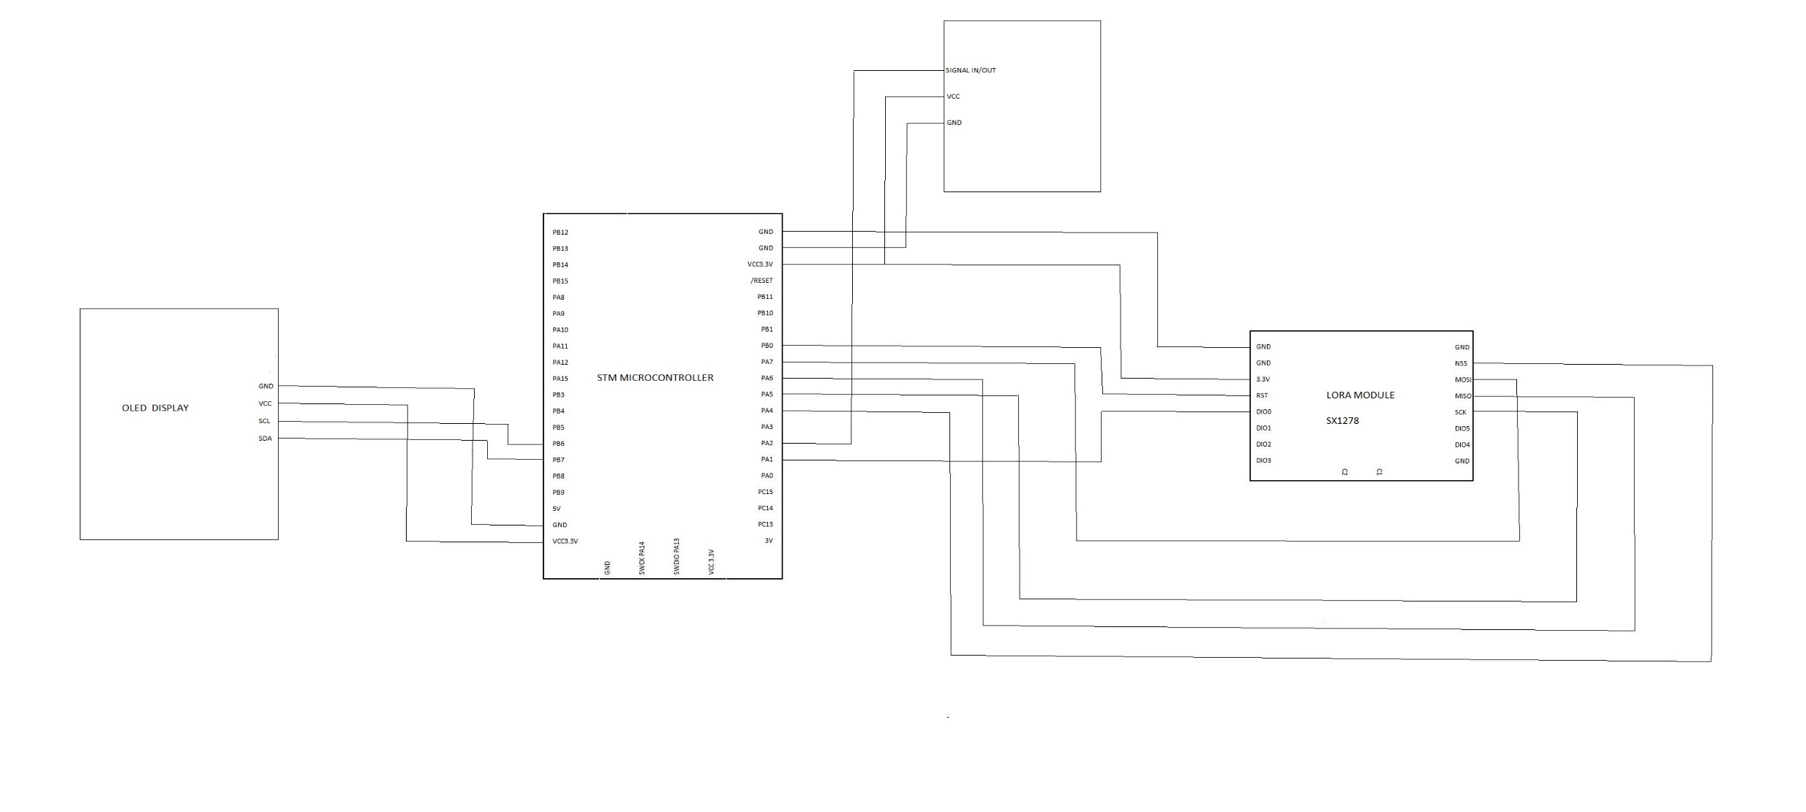
CIRCUIT DIAGRAM

Slide 6
THANK YOU

